Slide 1

Spring Faculty Meeting
Bloomington / IUPUI
April 3, 2009

Slide 2
MISSION STATEMENT:
The mission of the Indiana University School of Education is to improve teaching, learning and human development in a global, diverse, rapidly changing and increasingly technological society.

Slide 3
UNIVERSITY PRIORITIES
Recruiting excellent faculty
Facilitating inter-campus collaboration
Increasing graduation rates and certification programs
Developing a new master plan
Expanding academic initiatives focused on life sciences, arts & humanities, and internationalization
Increasing statewide partnerships

Slide 4
CURRENT CHALLENGES
Deepening economic crisis
Changing institutional practices
Changing state demographics
Increasingly hostile policy environment
Increasing competition

Slide 5
NEW OPPORTUNITES
Increasing DE capacity
Evolving new degree and certificate programs
Expanding international partnerships
Growing faculty competitiveness in funded research
Improving diversity

Slide 6
SOMETHING TO REMEMBER
“Behold the turtle. He only makes progress when he sticks his neck out”
James Bryant Conant
1893 -1978

Slide 7
An Overview of Future Initiatives and Fiscal Issues at Bloomington

Slide 8
2009
We expect to end this year in the black with a modest surplus
The surplus is not base money, it is one time money associated with a larger than projected entering class
We can’t - and should not - try to build this into the base budget. There is too much demographic & economic turbulence to be certain how the next few years will turn out.

Slide 10
Update on Bloomington Initiatives
Undergraduate Recruitment
Small signs of shifts in the right direction, undergraduate enrollment is up this semester
New direct admission program
Efforts to maintain contact and recruit students in U.D.
Praxis retention & diversity initiative
Graduate Enrollment
Distance Education Efforts
New green power saving initiative led by ETS
Notes:
Up nearly 600 undergraduate credit hours, a gain of 3%
Graduate credit hours down by approximately 800 or 8%, part of this may be the predicted slowing down of IRAP, unfortunately our data systems don’t permit fine grained analysis of precisely where we are down
27 people have signed up for on-line distance ed course
We begin measurement tomorrow. We ask people to leave their computers on for the duration of the study.
We will benchmark usage for two weeks.
Over the weekend of April 18th, ETS will install the automatic power off capability. We will measure the impact for another 2 weeks.
Once the study is over, and (I assume) the results are positive, we’ll continue with the power policy. People can also shut their computers down if they like.
This is intended to give us evidence of possible power savings not only for the SoE but for IUB and IU overall. We are working with UITS and the Sustainability office to then write up a “grant”. It’s possible that if we can prove we are really shutting computers down via a managed process, we may be able to get rebates from the power companies. So, besides the savings in CO2, we will reduce IU’s electricity bill and may get additional savings.

Slide 11
Notes:
ELPS – 71%
IST – 70%
CEP 67%
IST 70%
lcle 43%
C and I 42%

Slide 12
Summing Up
Our reserves should still get us through approximately 2 to 3 years, depending upon how enrollments and state funding unfolds.
Enough time to have launched some of our DE initiatives & continue our efforts to increase undergraduate enrollment.
While we cannot predict, we believe that there will be significant pressures to begin to reduce the rapid upward pressures in student aid assessments in the next 2-3 years.

Slide 13
Office of Research and Development
Several proposals submitted to NSF, NIH, various other agencies and private foundations since Fall faculty meeting
Upcoming Opportunities
Economic Stimulus
Great majority of funds going to Indiana ($1.3 Billion) will be distributed by formula to school districts although some may reach higher education
Governor’s plan has not yet been submitted

Slide 14
Teacher Quality Partnership Grants
$100 million dollars in current fiscal year
One of two activities must be undertaken
Strengthened Pre-Bac program needs to include:
High Needs partnership (either urban or rural)
Strong mentoring program with classroom teacher(s)
Empirically-based program including strong understanding of student data
Teacher Residency Post-Bac program
ONE year induction program with master’s at end of year
Strong partnership with High Needs School/District
Two optional activities
Prepare School Leaders for Rural Areas
Partner with a “digital education content developer” to improve pre-service program

Slide 15
IES Summer and Fall Deadlines
Institute for Educational Sciences (IES) at US Department of Education (http://ies.ed.gov/funding/
Research and Training Grants Due Dates
Summer
Letters of Intent (April 27, 2009) – Not Binding
Proposals (June 25, 2009)
Fall
Letters of Intent (August 3, 2009) – Not Binding
Proposals (October 1, 2009)
IES Proposal Workshop “Brown Bag” April 27th Noon – 2pm Room 2140

Slide 16
New Incentive
Support of PI’s who apply for higher indirect cost grants
PI will receive into their research account 35% of indirect that the SOE receives ABOVE 40%.
Example
A grant with $100,000 of direct costs would generate $54,000 of indirect costs if grant was at “full” indirect rate (54%)
President’s office takes 2.5% “off the top” so SOE actually receives $51,500 in indirect
35% of the difference between $51,500 and $40,000 is $4025 into PI’s research account
Allocation is done annually after end of each fiscal year

Slide 17
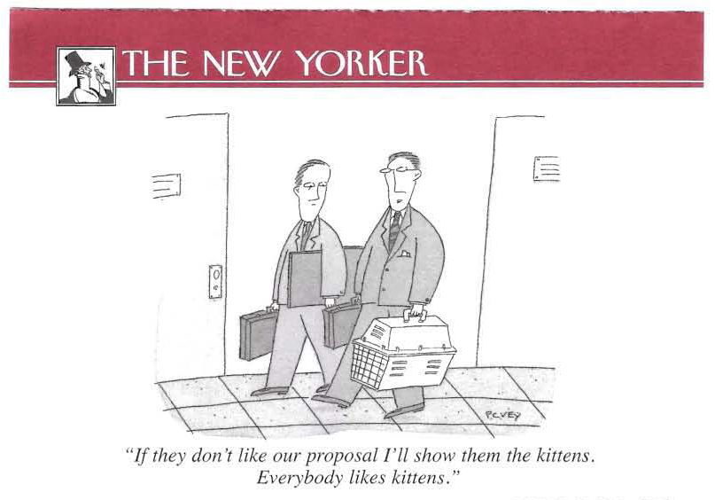
New additions to proposals

Slide 18
